Slide 1
Drug abusers analysis
Guide
Dr. Abdul Nizar
UG Dean
Submitted By
Anupama Regi
MCA S4
TVE20MCA-2017

Slide 2
introduction
Drug abuse is a striking public health problem in the world. It's use can results in drug addiction, illness and death.
Globally, some 35 million people are estimated to suffer from drug use disorders and who require treatment services, while only 1 in 7 people receive treatment ( according to the World Drug Report).
11 million people injected drugs, of whom 1.4 million live with HIV and 5.6 million with hepatitis C.
So it is really very important to detect those troubles as early as possible.
For this purpose ,Drug Abusers Analysis System will be of greater benefit to the society.

Slide 3
Problem statement
To develop a Machine Learning System called “Drug Abusers Analysis” to detect drug users and estimate users’ last consumption time using Random Forest (RF) based on personal features, including personality traits and demographic information.

Slide 4
Motivation
Drug use constitutes an important factor for increasing risk of poor health, earlier mortality and morbidity.
A number of factors are correlated with initial drug usage ;
Psychological, social, individual, environmental, and economic factors.
Not only negatively affects mental health but also closely relates to public health problems.
Prevention and treatment continue to fall short in many parts of the world, with only 1 of 7 people with drug use disorders receiving treatment each year.
In view of increasing use of drug and serious health consequences, drug abuse has been an important health issue globally.
Recently, accumulating evidence has suggested that drug use is associated with personality traits.

Slide 5
Objective
OBJECTIVE :
Drug Abusers Analysis aims to detect the drug users’ by RF based on personality features and demographic details.
And also to estimate users’ last consumption time

Slide 6
FIVE – FACTOR MODEL
Psychologists have largely agreed that the personality traits of the Five Factor Model (FFM) are the most comprehensive and adaptable system for understanding human individual differences.
Neuroticism (N), the tendency to experience negative emotions such as anxiety and depression;
Extraversion (E), the tendency to be sociable, warm, active, assertive, cheerful, and in search of stimulation;
Openness to Experience (O), the tendency to be imaginative, creative, unconventional, emotionally and artistically sensitive;
Agreeableness (A), the dimension of interpersonal relations, characterized by trust, modesty, and cooperativeness; and
Conscientiousness (C), a tendency to be organized, strong-willed, persistent, reliable, and a follower of rules and ethical principles.
Eg; Compared to never users, current cocaine/heroin users scored higher on Neuroticism and lower on Conscientiousness.

Slide 7
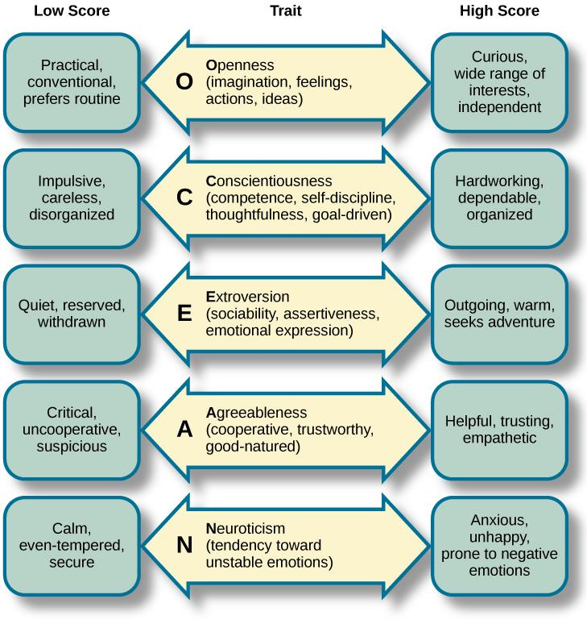

Slide 8
EXISTING SYSTEM
Medical tests are performed with the permission of the medical officers in order to detect the drug usage among the individuals.
Blood samples or urine samples are collected for achieving this task, and only from the test results , we could conclude that whether the individual has taken drugs or not.
In this system,
we are not able to identify how many peoples are using drugs
which type of drugs are used
which category are heavily addicted

Slide 9
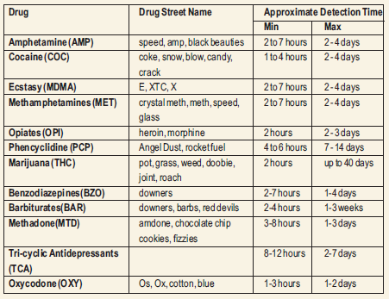

Slide 10
PROPOSED SYSTEM
Drug Abusers Analysis System is a machine learning project to detect drug users and estimate users’ last consumption time using Random Forest (RF) based on personal features, including personality traits and demographic information.
Each set of data can tell us some story. Our mission is to extract this story from the data and translate it into more readily accessible human language.
Problem which can be solved:
Drawbacks of existing system can be solved.
Seven class classifications for each drug separately.

Slide 11
Literature review
Predicting potential drug abusers using machine learning techniques
Drug Use and Personality Profiles
IEEE, 13 February 2020
IEEE, 27 April 2019
The Five Factor Model of personality and evaluation of drug consumption risk
Elaine Fehrman, Vincent Egan, Alexander N.Gordan, Jeremy Levesley, Evgeny M.Mirkes, Awas K.Muhammed
Zhaoying Qiao, Tianrui Chai,Qinjing Zhang,Xinyi Zhou,Zhuoling Chu
E. Fehrman, A. Muhammad, E. Mirkes, Vincent Egan, A. Gorban
IEEE, 20 June 2015

Slide 12
About Dataset
Database contains records for 1885 respondents.
For each respondent 12 attributes are known: Personality measurements which include NEO-FFI-R (neuroticism, extraversion, openness to experience, agreeableness, and conscientiousness), BIS-11 (impulsivity), and ImpSS (sensation seeking), level of education, age, gender.
Alcohol, Amphet, Amyl, Benzos, Caff, Cannabis, Choc, Coke, Crack, Ecstasy, Heroin, Ketamine, Legalh, LSD(Lysergic acid diethylamide), Meth, Mushrooms, Nicotine, Semer, VSA(Volatile substance abuse) are the classes of drugs consumption.
All categorical data were quantified.
https://archive.ics.uci.edu/ml/datasets/Drug+consumption+%28quantied%29

Slide 13
How our project contribute to the society
Can identify people who are addicted to drug.
Which type of drugs are used more.
Helpful for Educational institutions, local bodies etc.
Find which type of character(personality) of an individual is involved among the abused ones.

Slide 14
System Design
Extract needed data from the original dataset
Train model using Algorithm
Apply trained models to predict users last consumption time
Used in
Last year
Last 6 months
Within last 2 months
Last month
Last week
Last day
Never Used

Slide 15

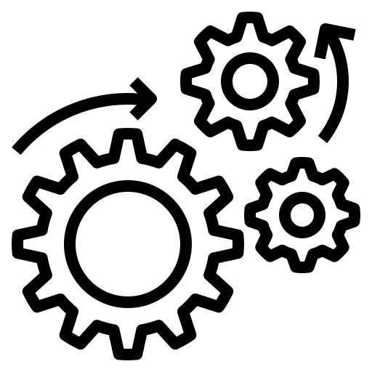

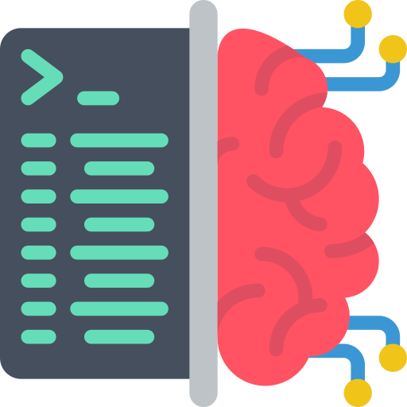

Work Flow
Data Pre Processing
Train Test Split
Drug Abusers Data
Random Forest Model
New Data
Classification
Trained Random Forest Model

Slide 16
DFD-Level0
DRUG ABUSERS ANALYSIS
Input FFM Scores
Result
Drug Abusers Classification
USER
Response

Slide 17
Level 1
Input Data
User Classification
Testing Data
Preprocessing
Preprocessed Data
Training Data
User Classification

Slide 18
Process Flow
LOAD DATASET
SPLIT THE DATASET FOR TRAINING AND TESTING
START
CSV file
UCI REPOSITORY
CLASSIFICATION
STOP
RESULT COMPARISON
VARIOUS ALGORITHM like RF, KNN, XGBoost, LightGBM

Slide 19
Implementation
STAGES;
New dataset were reconstructed by extracting relative input and output information from original dataset.
Splitting Ratio of training and testing set is 8:2
Training the model using different algorithms
Applying trained model to estimate users’ last consumption time

Slide 20
TOOLS
Operating System : Windows/Linux
Platform : Anaconda, Google Colab
IDE : VS Code
Browser: Chrome/Mozilla Firefox/Edge
Libraries Used : streamlit, pickle, sklearn, pandas

Slide 21
Result analysis
Compared with SVM, KNN, Naive Bayes, Decision Tree, Logistic Regression, XGBoost, LightGBM
For classifying users’, Random Forest , XGBoost, SVM has excellent performance than other methods.
Although Random Forest and XGBoost had almost same accuracy in predicting potential users and estimating last usage time , the performance of Random Forest is more satisfactory (ability to control overfitting).
Age is an important factor in estimating last usage time.
Amyl, Crack, Heroin, Ketamine, Meth, Semer and VSA has good Accuracy level compared to other models.

Slide 22
Analysis
Model | Random Forest | SVM | LightGBM | XGBoost | KNN
Amyl | .65 | .69 | .37 | .68 | .64
Caff | .76 | .69 | .70 | .72 | .63
Crack | .85 | .85 | .84 | .85 | .85
Heroin | .84 | .80 | .82 | .83 | .84
Ketamine | .76 | .81 | .74 | .76 | .75
Meth | .73 | .77 | .72 | .73 | .73
Semer | .98 | .99 | .99 | .98 | .99
VSA | .77 | .77 | .75 | .77 | .74

Slide 23
conclusion
In this work, machine learning algorithms are applied to predict potential user and estimate users last consumption time for all 19 drugs.
For all drugs RF has best performance in predicting potential user as well as estimating usage time.
Therefore, RF is a powerful tool to predict drug use risk when compared to other algorithms.
It seems that demographic information is less important. However, when we only use personality traits as input features, accuracy of algorithms drops.
Thus, Demographic information also does some part in predicting drug abuse.

Slide 24
Future scope
Add some modules like how to cure the users’ who are too much addicted in drugs.
Predict the reason for the addiction from their background.
Also helps the organization to finds the behavior of users’ by analyzing them.
By using this as a campaign in local bodies can find the problems of users’ who are using the drugs and collect data.

Slide 25
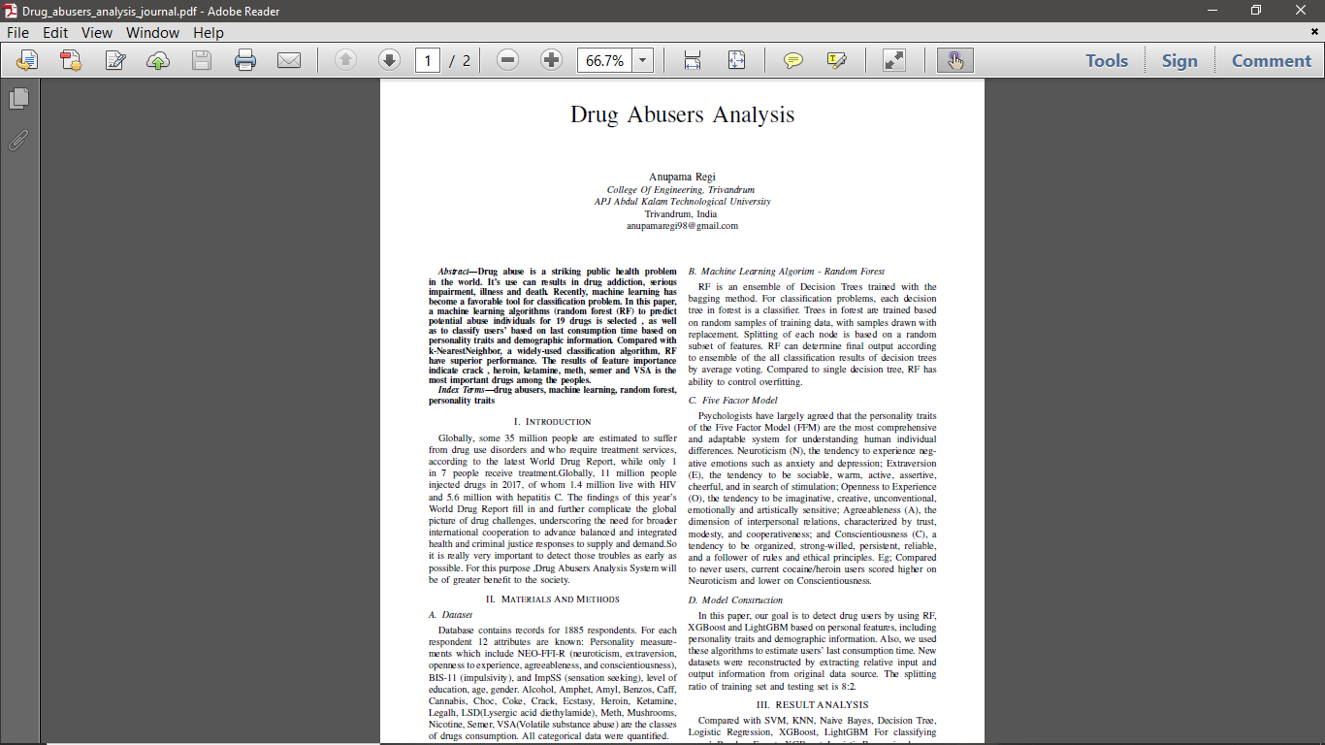
publication

Slide 26
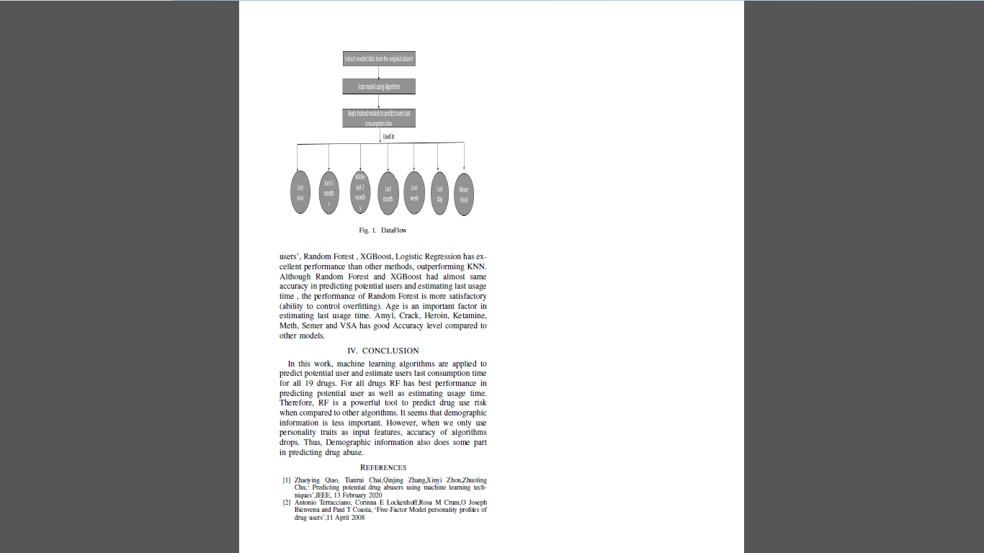

Slide 27
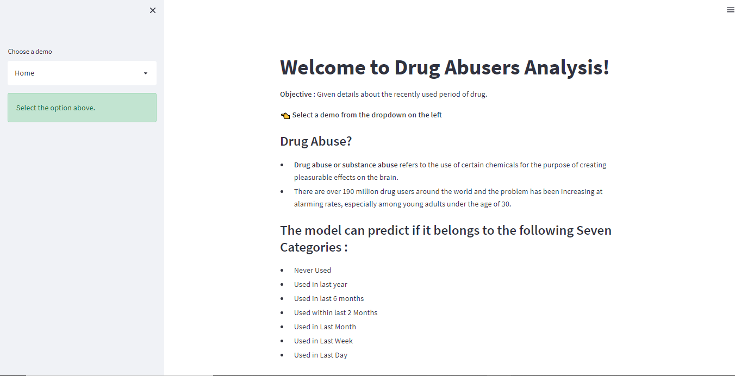
screenshots

Slide 28
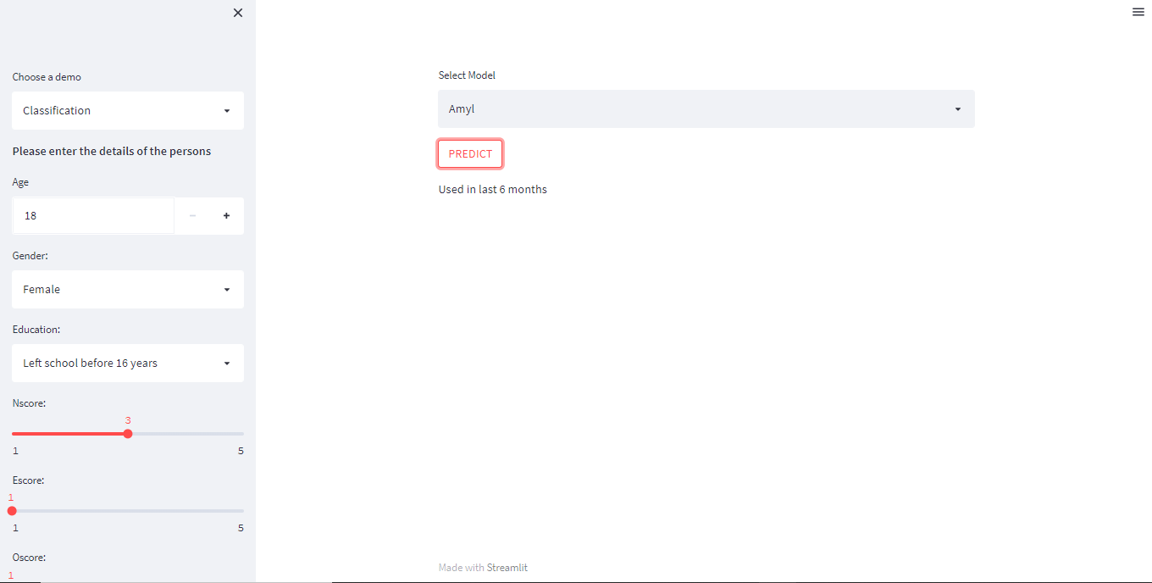

Slide 29
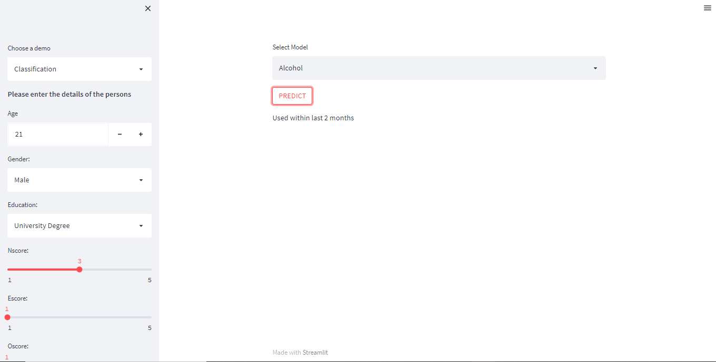

Slide 30
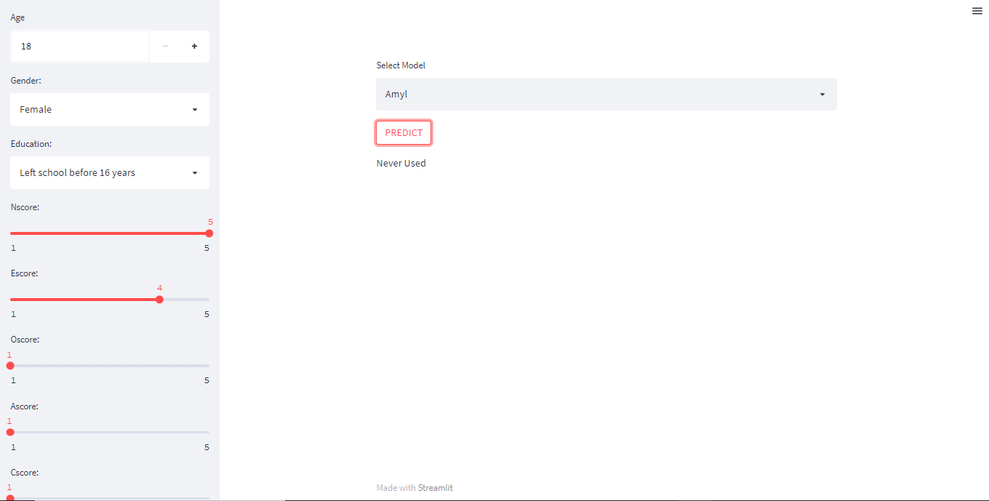

Slide 31
References
Zhaoying Qiao, Tianrui Chai,Qinjing Zhang,Xinyi Zhou,Zhuoling Chu,‘ Predicting potential drug abusers using machine learning techniques’,IEEE, 13 February 2020
Antonio Terracciano, Corinna E Lockenhoff,Rosa M Crum,O Joseph Bienvenu and Paul T Coasta, ‘Five-Factor Model personality profiles of drug users’,11 April 2008
G. Shobana, S. Nikkath Bushra, "Drug Administration Route Classification using Machine Learning Models", 2020 3rd International Conference on Intelligent Sustainable Systems (ICISS), pp.654-659, 2020.
https://archive.ics.uci.edu/ml/machine-learning-databases/00373/
https://www.lalpathlabs.com/blog/screening-tests-for-drug-abuse

